Slide 1
Estimating With
PROBE
Personal Software ProcessSM
for Engineers: Part I

Slide 2


Slide 3
Lecture Topics
Planning overview
Why estimate size?
Size estimating principles
The PROBE estimating method
Size estimating proxies
Estimating examples

Slide 4
Planning Overview
Plans
  allow you to make commitments that you can meet
  provide the basis for agreeing on job scope, schedule, and resources
  guide the work
  facilitate progress tracking and reporting
  help ensure that key tasks are not overlooked

Slide 5
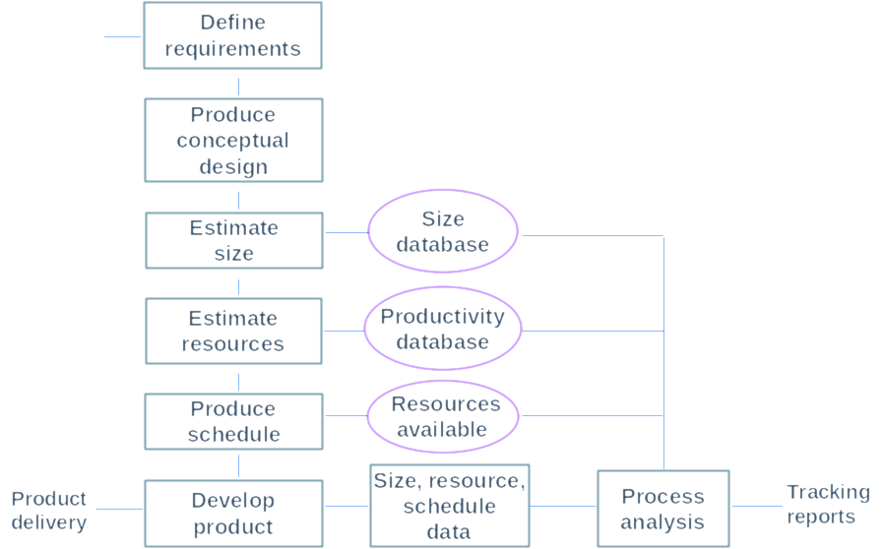
The Project Planning Framework

Slide 6
The Planning Process
Before making the plan, you must have a requirement.
  The better the requirement, the better the plan.
  With ill-defined requirements, expect to make frequent plan updates.
Plans are most accurate when based on size estimates and historical data.
With a size estimate and historical data, you can
  identify the data on the most similar prior work
  base the resource estimate on these data

Slide 7
Size Estimating Principles -1
Estimating is an uncertain process.
  No one knows how big the product will be.
  The earlier the estimate, the less is known.
  Estimates can be biased by business and other pressures.
Estimating is an intuitive learning process.
  Ability improves with experience and data.
  Some people will be better at estimating than others.
The objective is to become consistent.
You will then understand the variability of your estimates.
You seek an even balance between under- and overestimates.

Slide 8
Balanced Estimates
40
Majority are under-estimating
Balance of over- and underestimates
Much tighter balance around zero
40
PSP 0
20
20
0
0
-
-
200%
200%
-
-
100%
100%
0%
0%
100%
100%
40
40
PSP 1
20
20
0
0
-
-
200%
200%
-
-
100%
100%
0%
0%
100%
100%
40
40
PSP 2
20
20
0
0
-
-
200%
200%
-
-
100%
100%
0%
0%
100%
100%

Slide 9
Size Estimating Principles -3
The advantages of using defined estimating methods are that you
  have known practices that you can improve
  have a framework for gathering estimating data
  can consistently use historical data to produce balanced estimates

Slide 10
Estimating with PROBE
The PSP uses the PROBE method to estimate and plan projects.
PROBE stands for PROxy Based Estimating.
PROBE uses proxies to estimate program size and development time.
A good proxy will help you to make accurate estimates.

Slide 11
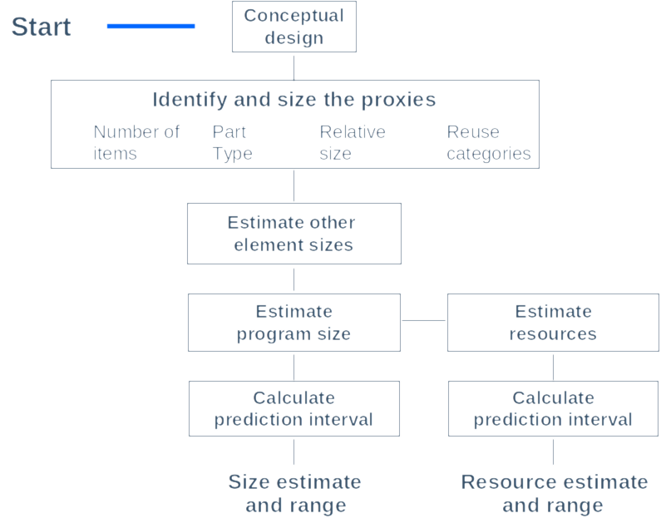
The PROBE Estimating Method

Slide 12
Conceptual Design -1
The first estimating step is to make a conceptual design:
  relate the requirements to the product,
  define the product elements that will produce the desired functions,
  estimate the size of what you plan to build.
For most projects, the conceptual design can be produced relatively quickly.
For the PSP exercise programs, try to limit your conceptual design time to 10, or at most 20, minutes.

Slide 13
Conceptual Design -2
To make a conceptual design, identify the product functions and the program parts needed to produce them.
In effect, you say: “If I had the following parts, I could build this product.”
Then, compare these parts to programs you have already written and estimate their sizes.
Finally, combine the part estimates to give total size.
If you do not understand the product well enough to make a conceptual design, you do not know enough to make a plan.

Slide 14
Size Estimating Proxies
A good proxy should correlate closely to development costs.
A good proxy should be easy to visualize early in development.
It should also be a physical entity that can be measured.

Slide 15
Example: Building Costs
Problem
  The builder needs to know the floor area (in sq. ft.) to estimate the cost of construction.
  Clients normally cannot describe their needs in square feet.
  They usually can describe the type and number of rooms they want.
Solution
  Use rooms as a proxy for size.
  Use historical (typical) data to translate from rooms to square feet.
Notes:
To explain how proxies work for estimating, let's look at an example from outside the software field.

Slide 16
Example: Customer Requirements
Bedrooms: | 1 large, 2 medium, and 1 small
Bathrooms: | 1 large and 2 medium
Kitchen: | 1 medium
Living room: | 1 large
Dining room: | 1 medium
Family room: | 1 large
Utility: | 1 medium
Notes:
A client might have the following requirements for their new house.

Slide 17
Historical Building Data
 | Small | Medium | Large
Bedrooms | 90 | 140 | 200
Bathrooms | 25 | 60 | 120
Kitchens | 100 | 130 | 160
Living rooms | 150 | 250 | 400
Dining rooms | 100 | 140 | 200
Family rooms | 150 | 240 | 340
Utility | 25 | 50 | 80
Notes:
The builder can use historical data to build this table showing typical room sizes.

Slide 18
Proxy Calculation
Bedroom | 1 large | = | 1 x | 200 | = | 200
Bedroom | 2 medium | = | 2 x | 140 | = | 280
Bedroom | 1 small | = | 1 x | 90 | = | 90
Bathroom | 1 large | = | 1 x | 120 | = | 120
Bathroom | 2 medium | = | 2 x | 60 | = | 120
Kitchen | 1 medium | = | 1 x | 130 | = | 130
Living room | 1 large | = | 1 x | 400 | = | 400
Dining room | 1 medium | = | 1 x | 140 | = | 140
Family room | 1 large | = | 1 x | 340 | = | 340
Utility | 1 medium | = | 1 x | 50 | = | 50
 |  | Total (sq. ft.) |  |  | = | 1870
Notes:
We can combine the two sets of information to calculate the estimated area of the client's new house.
Could animate this to fill in the table in stages. Start with the first 2 columns, then add the rest of each row (row 1, row 2, then the rest, with total row as final step)

Slide 19
Example: The Builder’s Estimate
The first estimation step provides the builder with the proxy data for room size.
However, there are many other cost elements in home construction.
Builders typically have extensive data to relate room size to the other building costs.
With agreed initial plans, builders typically require detailed architectural specifications and estimates before quoting a price.
Notes:
For software development, we need to identify suitable proxies.

Slide 20
Proxies for estimating software
Classes, functions, and procedures:
When classes are selected as application entities, they can be visualized early in development.
Functions and procedures can often be estimated in the same way.
Classes, functions, procedures, and their sizes can be automatically counted.
Correlation with development hours:
Numbers of classes correlates reasonably well.
Class size correlates very closely.
With a good correlation, calculate program size from the relationship between class size and program size, considering historic data.
Notes:
For software development, we need to identify suitable proxies.

Slide 21
Estimating with Proxies
Once you have selected a proxy, you must:
  obtain proxy data,
  organize the data for use in estimating,
  use the data to estimate the size of the proxies in the new program,
  combine the proxy estimates into the product estimate,
  make a resource estimate,
  produce a project plan.
The PROBE method shows you how to perform these steps.

Slide 22
Organizing Proxy Data
A common way to estimate is to:
  break the planned product into parts,
  relate these planned parts to parts you have already built,
  use the size of the previously built parts to estimate the
  sizes of the new parts.
To do this, you need size ranges for the types of parts you typically develop.
For each product type, you also need size ranges to help judge the sizes of the new parts.

Slide 23
Example C++ Class Size Ranges
LOC per item
Type | VS | S | M | L | VL
Calculation | 2.34 | 5.13 | 11.25 | 24.66 | 54.04
Data | 2.60 | 4.79 | 8.84 | 16.31 | 30.09
I/O | 9.01 | 12.06 | 16.15 | 21.62 | 28.93
Logic | 7.55 | 10.98 | 15.98 | 23.25 | 33.83
Set-up | 3.88 | 5.04 | 6.56 | 8.53 | 11.09
Text | 3.75 | 8.00 | 17.07 | 36.41 | 77.66

Slide 24
Estimating Program Size
Just as homes have square feet that are not in rooms, programs have code that is not in the program parts.
  includes,
  declarations,
  other overhead functions.
The development job, however, must also produce this overhead code.
The size of this additional overhead code is usually proportional to the size of the program’s parts.

Slide 25
Estimating Development Time
With sound estimating methods, actual program size will be closely related to estimated program size.
The differences will be due to the overhead code and the estimating error.
Actual development time is also often related to estimated program size.
Again, with sound methods, the differences will be largely due to overhead activities and estimating error.

Slide 26
Statistically-Based Estimates
PROBE uses historical data, linear regression, and the prediction interval to produce estimates of known accuracy.
Regression provides the best fit, or minimum variance, of a line to these data.
The variance of the data is used to determine the likely estimation error.
The greater the variance, the larger the likely error.

Slide 27
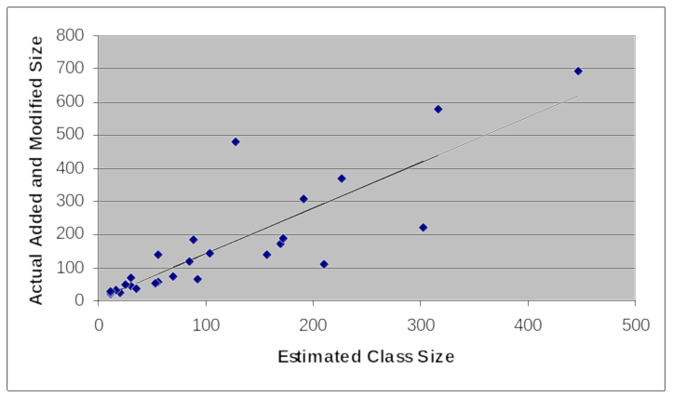
Regression Line for Program Size
27 C++ programs

Slide 28
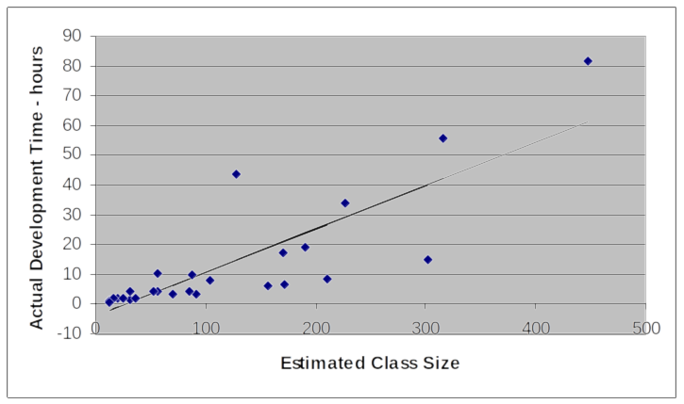
Regression Line for Development Time
27 C++ programs

Slide 29
PROBE: Estimating methods
Depending on the quality of your data, select one of the four PROBE estimating methods.
Method
A | regression with estimated proxy size
B | regression with planned added and modified size
C | the averaging method
D | engineering judgment
To use regression method A or B, you need:
a reasonable amount of historical data,
data that correlate,
reasonable β₀ and β₁ parameter values.

Slide 30
Method A (Regression): Estimated Proxy Size
Method A uses the relationship between estimated proxy size (E) and actual
  added and modified size
  development time
The criteria for using this method are
  three or more data points that correlate (R2 > 0.5)
  reasonable regression parameters (table 6.6 on pg. 96)
  completion of at least three exercises with PSP1 or higher

Slide 31
Method B (Regression): Plan Added and Modified Size
Method B uses the relationship between plan added and modified size and
  actual added and modified size
  actual development time
The criteria for using this method are
  three or more data points that correlate (R2 >0.5)
  reasonable regression parameters (table 6.6 on pg. 96)
  completion of at least three exercises with PSP0.1 or higher

Slide 32
Method C: Averaging
Method C uses a ratio to adjust size or time based on
historical averages.
The averaging method is easy to use and requires only one
data point.
Averages assume that there is no fixed overhead.

Slide 33
Method D: Engineering Judgment
Estimating with PROBE II
Use method D when you don’t have historical data.
Use judgment to
  project the added and modified size from estimated part size
  estimate development time
Use method D when you cannot use methods A, B, or C.

Slide 34
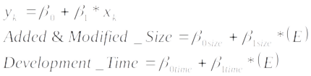
Method A: Estimating Size and Time -1
To project a program’s size or development time, find the equation for the regression line.
Then use the regression formula to project size and time.
E is the estimated proxy size.

Slide 35
Method A: Estimating Size and Time -2
Calculate the regression parameters b0 and b1 from data on previously developed programs.
For x, use estimated proxy size (E).
For y, use the actual
    added and modified size for the size estimate
    total development time for the time estimate
Calculate two sets of b0 and b1 regression parameters: one for size and the other for time.

Slide 36
Method A: Calculating Total Program Size
Total program size includes added, modified, deleted, base, and reused code.
When modifying an existing program, base code is the size of the unmodified existing program.
When modifying programs, include their unmodified size in base code and not in reuse.
While base code is a form of reuse, the PSP only counts unmodified code from the reuse library as reused.

Slide 37
Method A: Completing the Estimate
To complete the size estimate, calculate the
  projected added and modified size with the size regression parameters
  total program size, including added, modified, deleted, base, and reused code
  estimated new reusable code to be added to the reuse library
The completed estimate includes estimated development time calculated with the time regression parameters.

Slide 38
Method A: Completed Example -1
Base program (B) | 695 LOC
Deleted (D) | 0 LOC
Modified (M) | 5 LOC
Base additions (BA) | 0 LOC
Added parts (PA) | 115+197+49 = 361LOC
Reused parts (R) | 169 LOC
Estimated size E | = BA + PA + M = 366 LOC

Slide 39
Method A: Completed Example -2
Starting with E = 366, use the size regression parameters to calculate the projected size (P).
β_{0Size} = 62 and β_{1Size} = 1.3
Projected size P = 62 + 1.3 * 366 = 538 LOC
Total size T = 538 + 695 - 5 + 169 = 1397 LOC
Estimated total new reusable = 49 LOC
Note: Modified size is subtracted so it is not included twice.

Slide 40
Method A: Completed Example -3
Starting with E = 366, use the time regression parameters to calculate development time.
β_{0Time} = 108 and β_{1Time} = 2.95
Development time = 108 + 2.95 * 366 = 1186 min.

Slide 41
Messages to Remember
Accurate size estimates will help you to make better development plans.
Estimating skill improves with practice.
A defined and measured process provides a repeatable basis for improvement.
To make accurate estimates, you must use historical data and follow sound methods.
The PROBE method shows you how to do this.

